Slide 1

Chandrayaan: India's Journey to the Moon

Slide 2

The Beginning: Chandrayaan-1 (2008)
1
2
3
Pioneering Mission
Lunar Orbit & Impact
Water Discovery
India's first deep space mission, launched on October 22, 2008, by ISRO.
Orbited the Moon and deployed the Moon Impact Probe (MIP) near the south pole.
Confirmed discovery of water molecules on the lunar surface using NASA’s Moon Mineralogy Mapper.

Slide 3
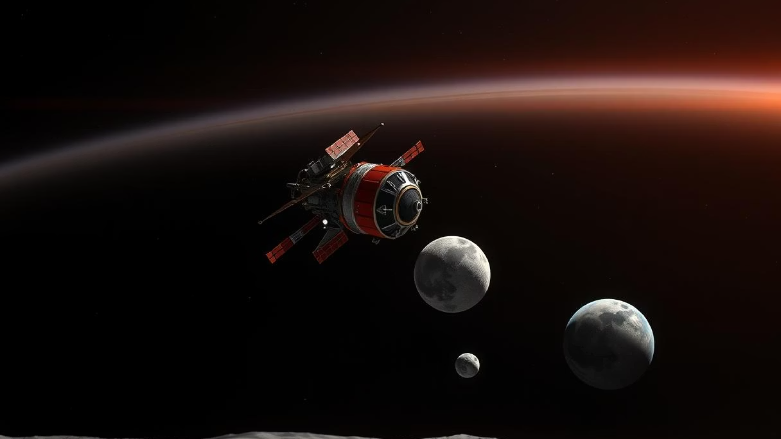
India Becomes 4th Nation to Reach Lunar Surface

Slide 4


Chandrayaan-1’s Scientific Breakthroughs
Mapped Moon’s chemical, mineralogical, and photogeologic features in infrared, visible, and X-ray light.
Mission ended early in August 2009 due to power issues but achieved 95% of objectives.
Detected water ice in permanently shadowed craters and water molecules in sunlit regions.

Slide 5
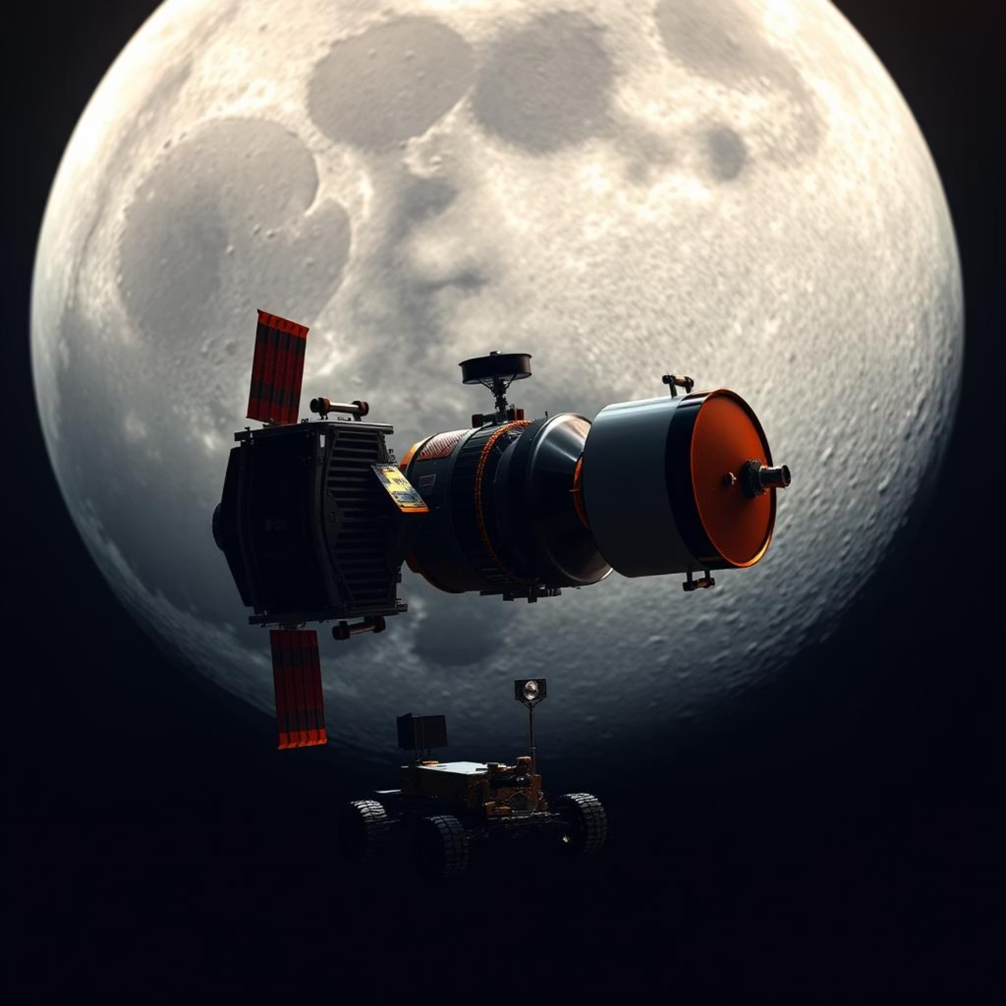
Chandrayaan-2: Ambition Meets Challenge (2019)
-Ambitious Launch
Launched July 22, 2019, included orbiter, lander (Vikram), and rover (Pragyan).
-Orbiter Success
Orbiter continues to operate with advanced instruments mapping lunar surface and atmosphere.
-Lander Challenge
Lander crashed during descent near lunar south pole, but mission provided valuable data.

Slide 6

Chandrayaan-3: Historic South Pole Landing (2023)
Launch & Soft Landing
Pioneering Feat
On-site Experiments
Launched July 14, 2023; successfully soft-landed on August 23, 2023, near lunar south pole.
India became first country to land on Moon’s south pole region and fourth overall to soft land on Moon.
Lander Vikram and rover Pragyan conducted in-situ experiments for ~14 Earth days.

Slide 7
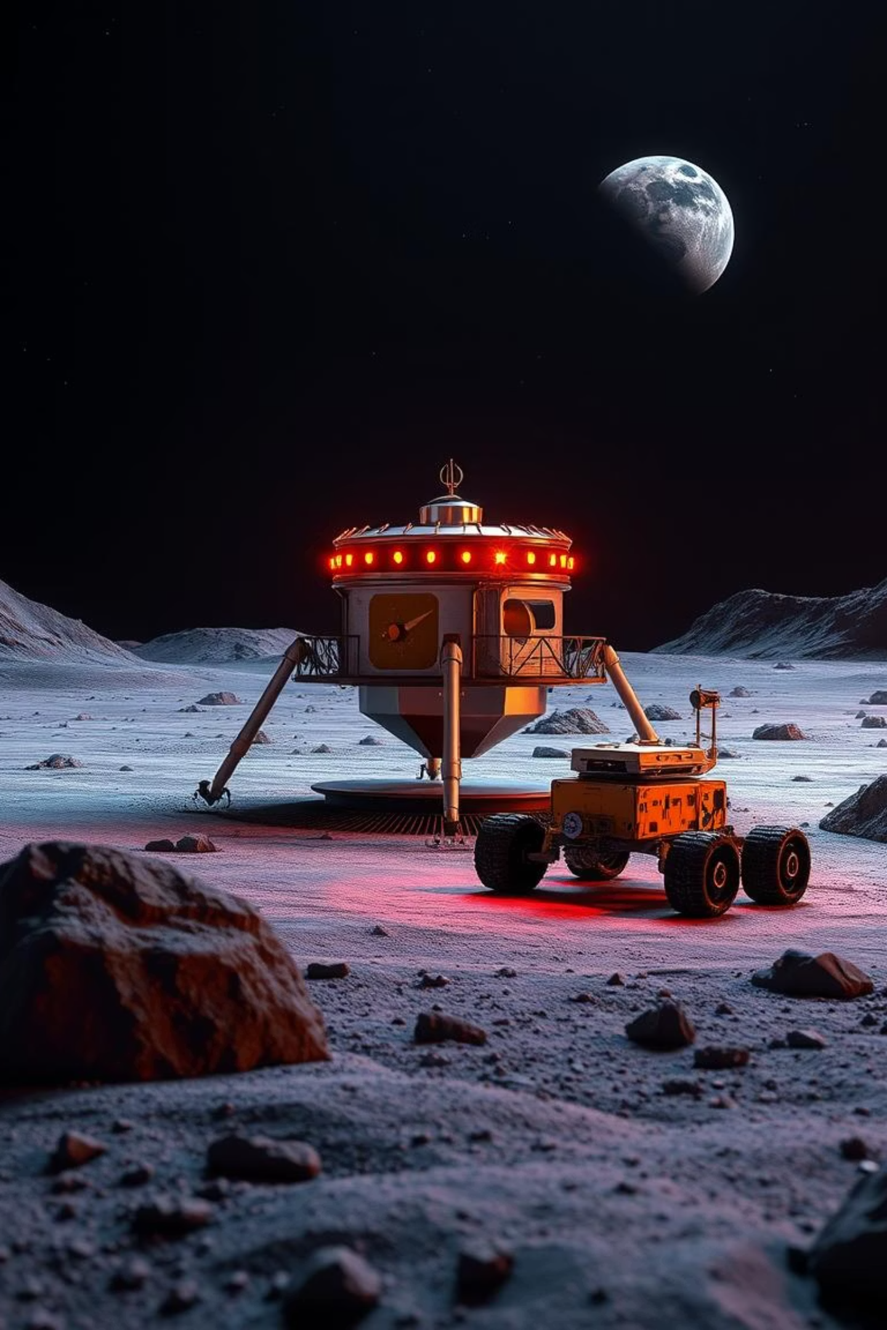
First-Ever South Pole Soft Landing

Slide 8




Chandrayaan-3 Mission Highlights
Advanced Technologies
Hazard detection, precision landing, and rover mobility demonstrated.
Scientific Payloads
Measured lunar surface composition, seismic activity, and thermal properties.
Propulsion Module
Continues Earth observation from lunar orbit post-landing mission.

Slide 9


The Chandrayaan Programme: A Vision for Lunar Exploration
Global Collaboration
Program Evolution
Future Missions
Technological Innovation
Scientific Goals

